Slide 1
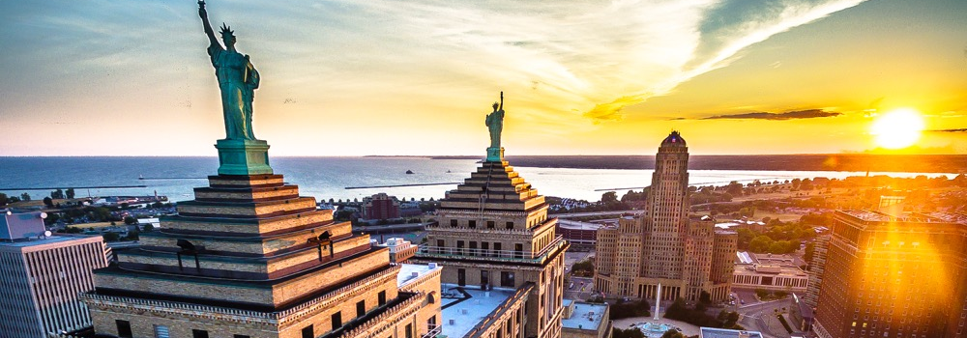



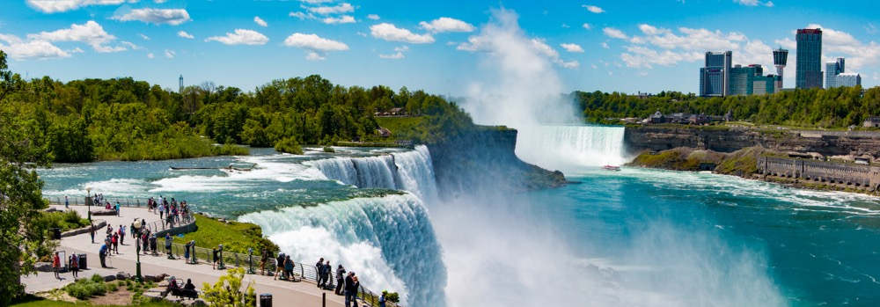
A program of Invest Buffalo Niagara

Slide 2

Where life is
in balance
Live Comfortably
Work Productively
Play Constantly

Slide 3
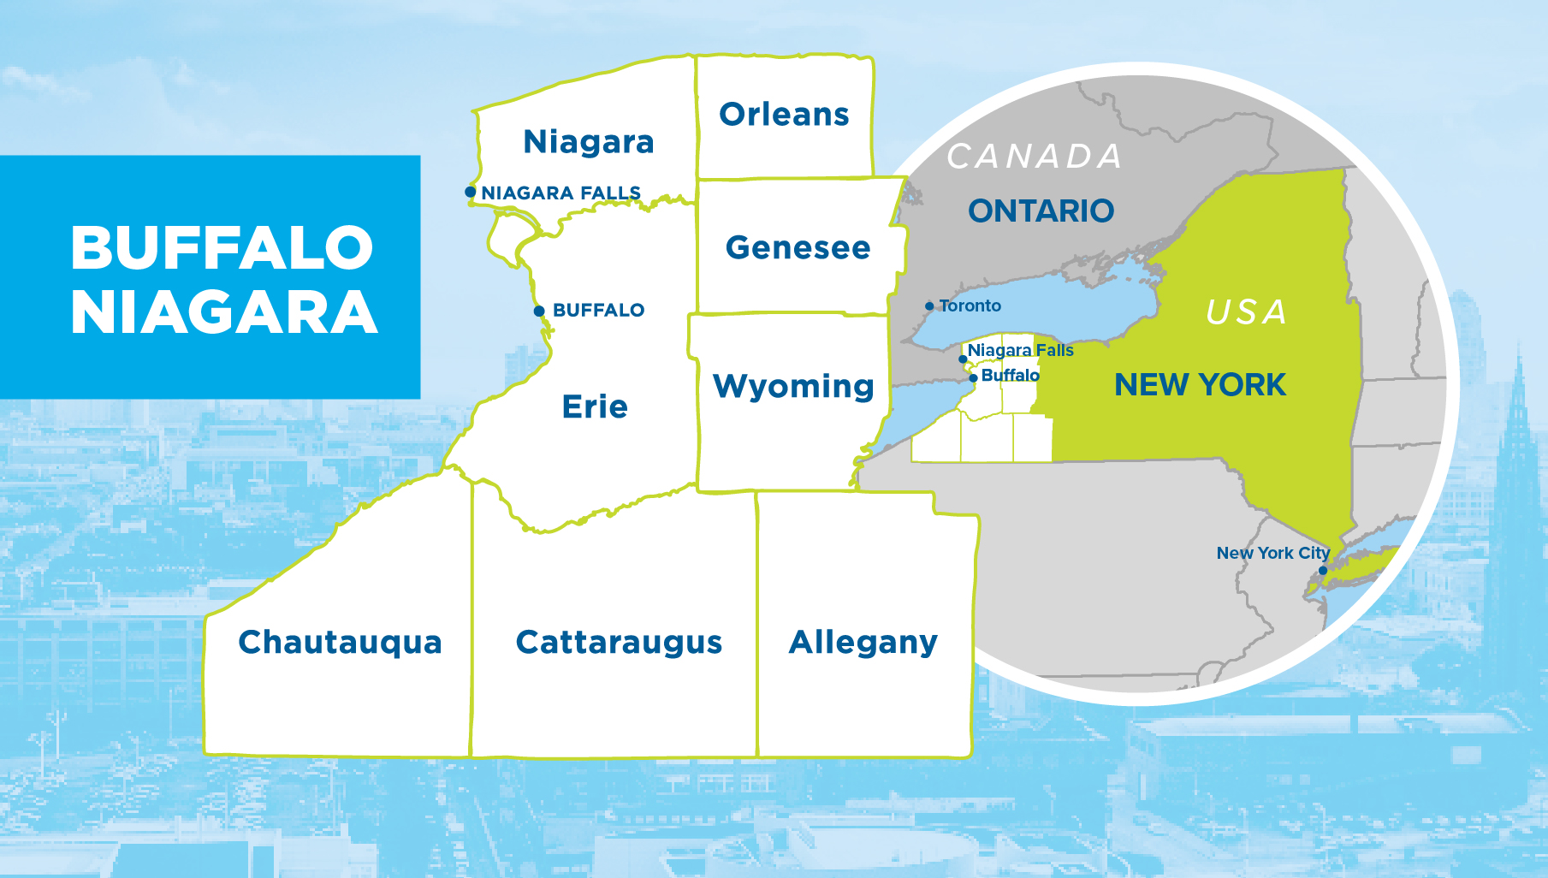

Slide 4



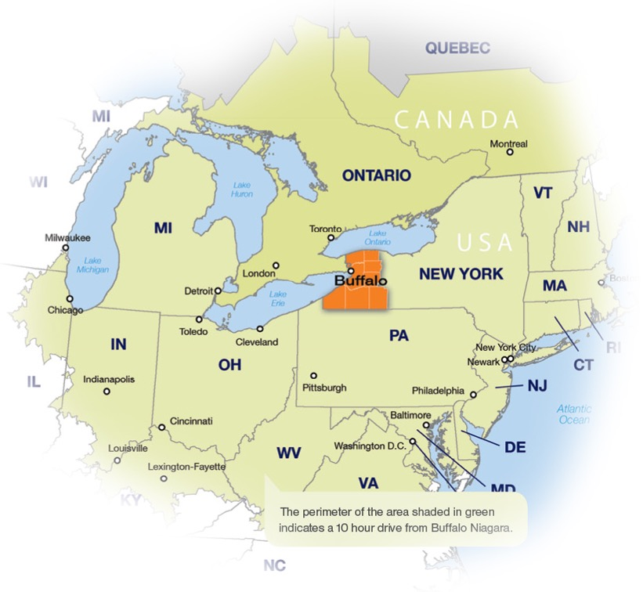
Average one-way airfare
from New York is
34.2% more expensive
than in Buffalo Niagara
More time to
work and play
Average commute time is
20.9 minutes, 4.6 minutes less than the national average.
NYC’s average annual commute is 67% greater than in Buffalo Niagara, that’s 9.7 days longer!

Slide 5
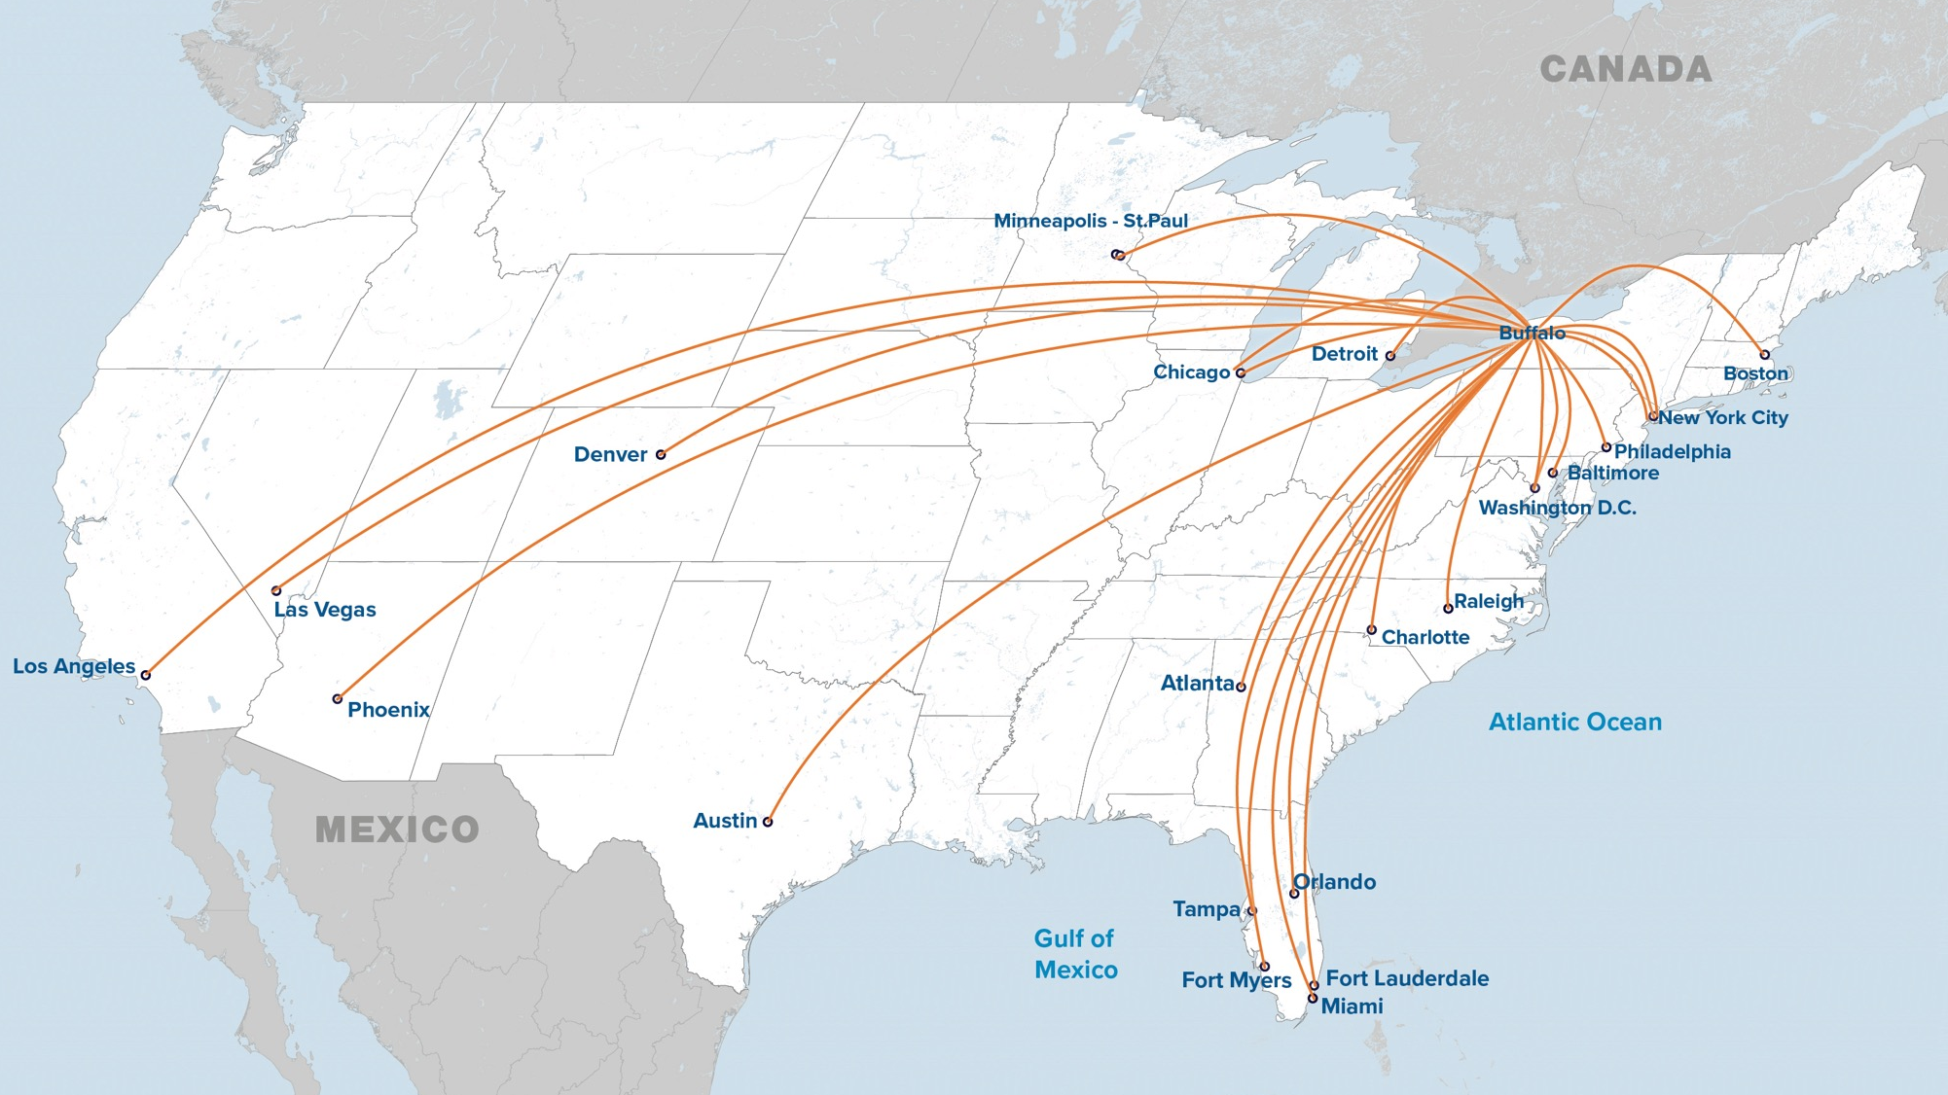
23 Direct flights

Slide 6
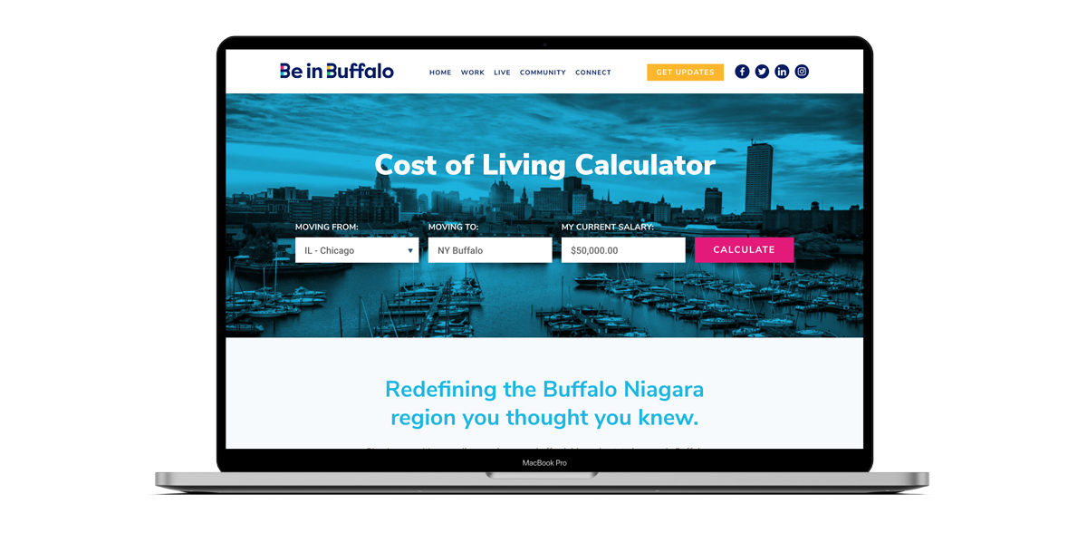

Slide 7
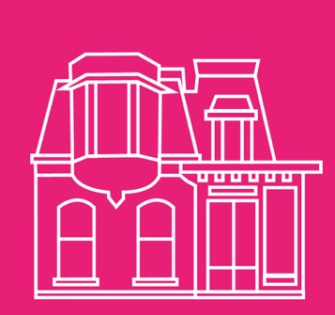
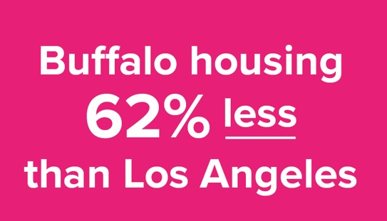

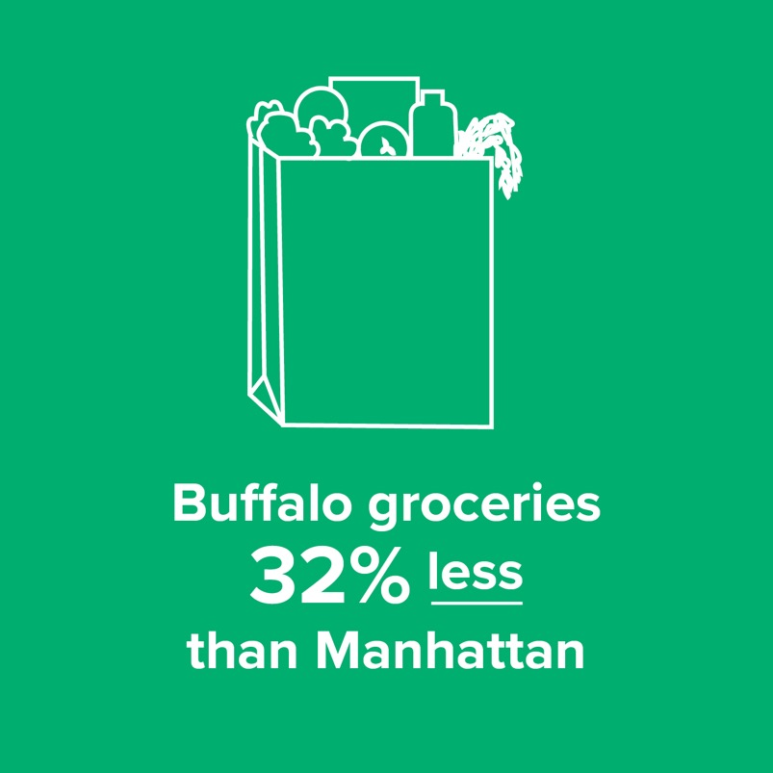
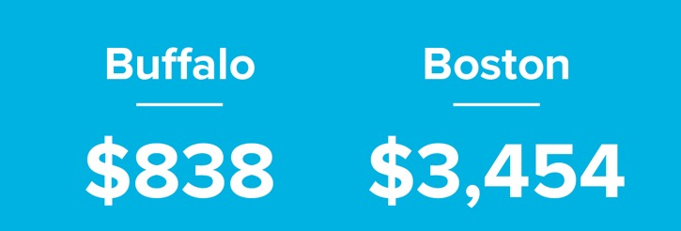
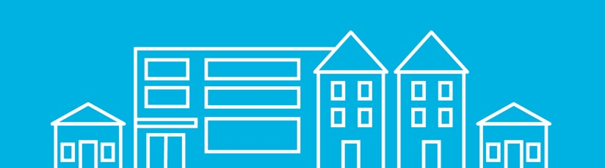
Average rent cost comparison

Slide 8
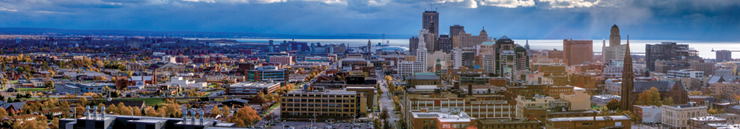

Median home price is 40% below the national average
2018, Q4
Philadelphia
$240,600
Nashville
$264,000
Phoenix
$272,700
NYC
$403,000
Denver
$438,300
Seattle
$489,600
San Jose
$1,250,000
Chicago
$243,000
Orlando
$265,000
Washington DC
$417,400
Boston
$460,300
Buffalo
$154,200
Dallas
$254,900

Slide 9
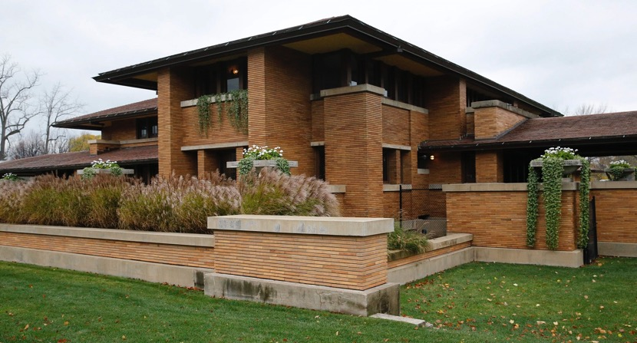
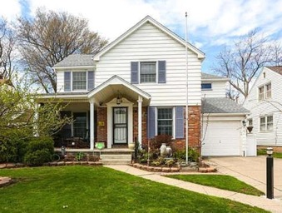
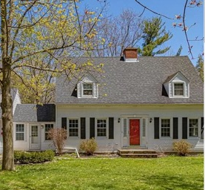
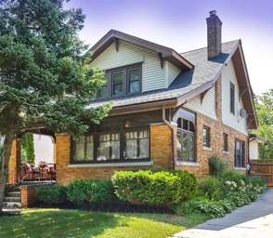
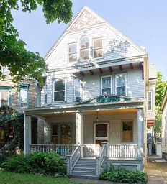
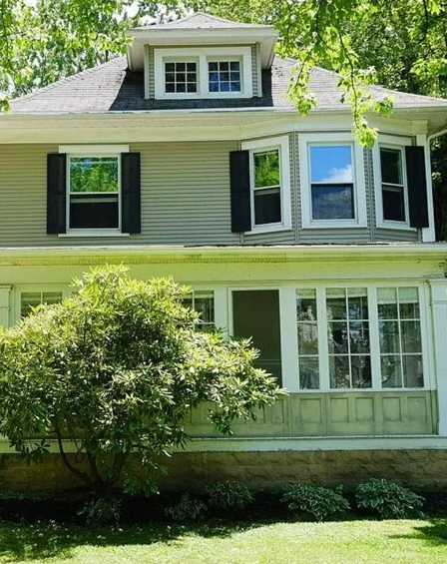
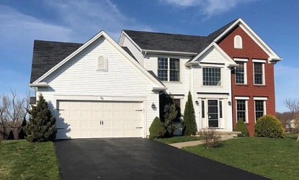
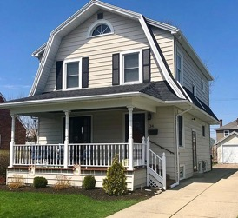
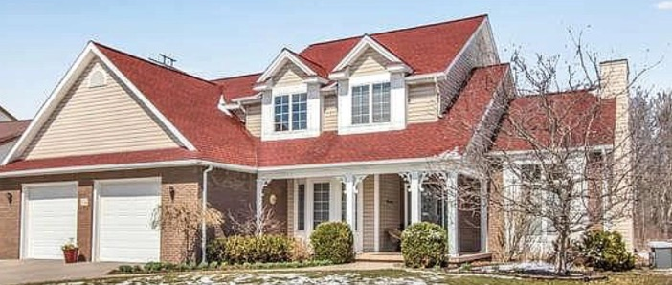
Where home ownership is a reality
Buffalo: $229K
Buffalo: $289K
Kenmore: $250K
Orchard Park $400K
Jewett Pkwy, Buffalo: Priceless
#4 most affordable housing market in the U.S. among regions with populations
of at least 500,000
National Association of Homebuilders
Lancaster: $350K
Kenmore $219K
Hamburg: $242K
Getzville: $325K

Slide 10
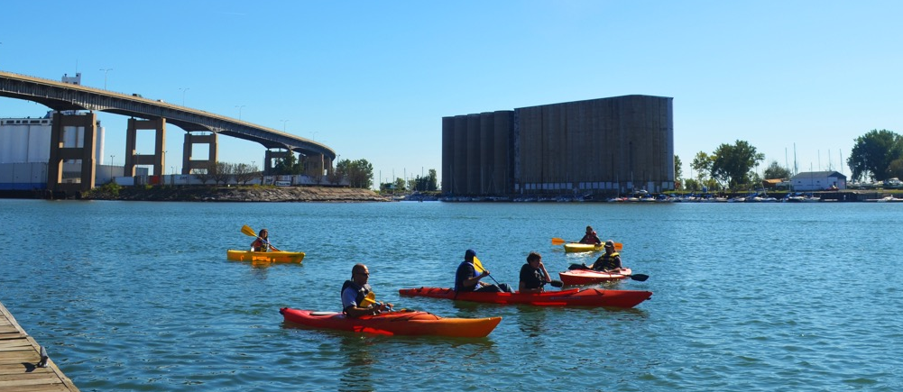
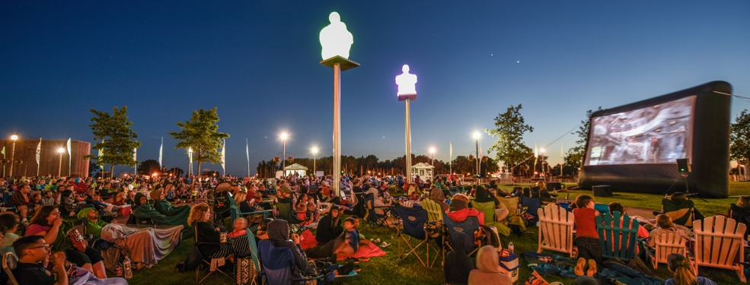
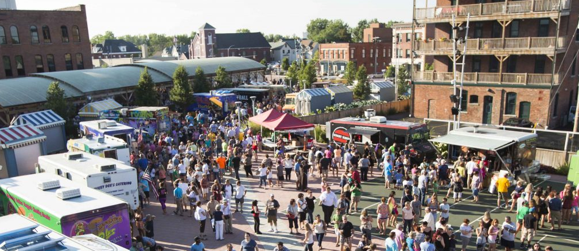
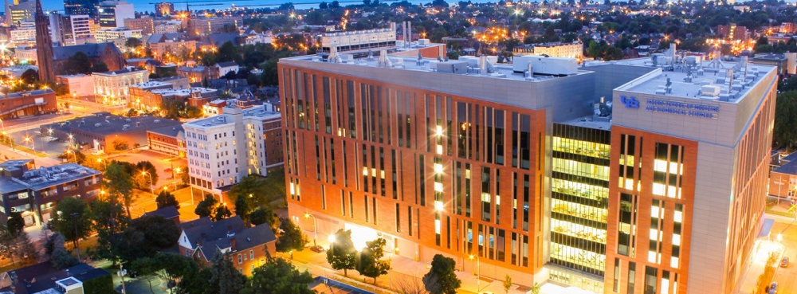
Developing Our Community

Slide 11
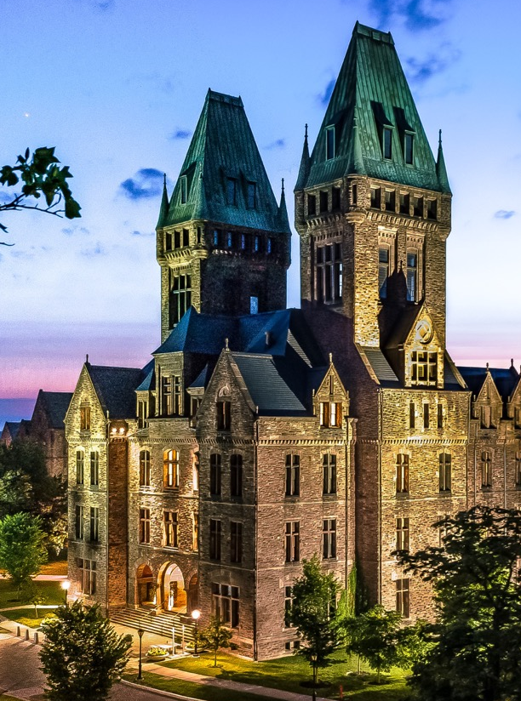
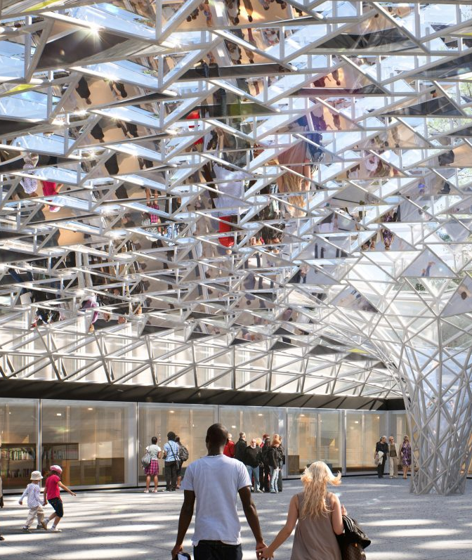
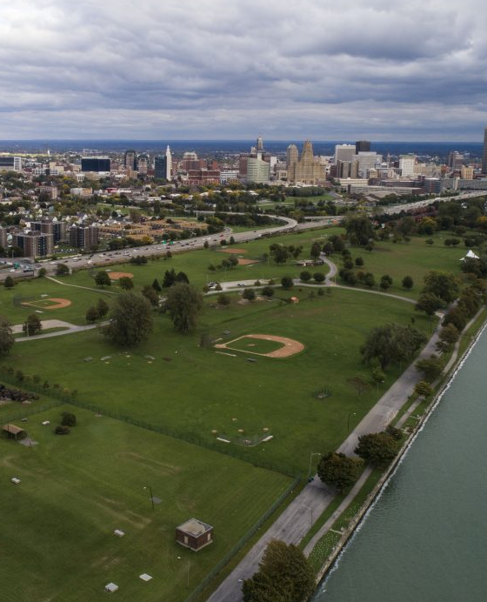
More to Come

Slide 12
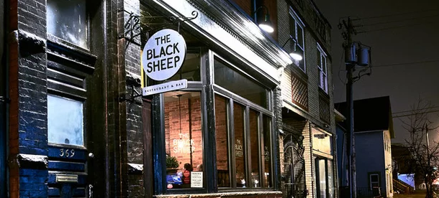




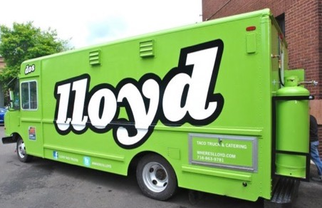
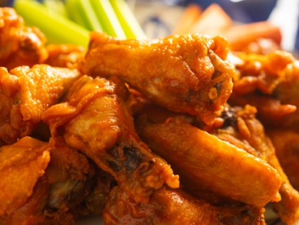

Big city fun without the big price tag
  Average Ticket Prices
      NFL:
      Buffalo Bills: $70
      New York Jets: $94
      New York Giants: $115
      Source: Statistics, April 2018
      NHL:
      Buffalo Sabres: $58
      New York Rangers: $180
      New York Islanders: $102
      Source: SealGeek, April 2019

Slide 13

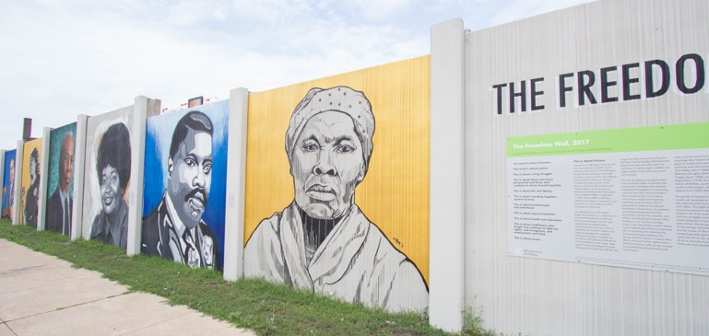
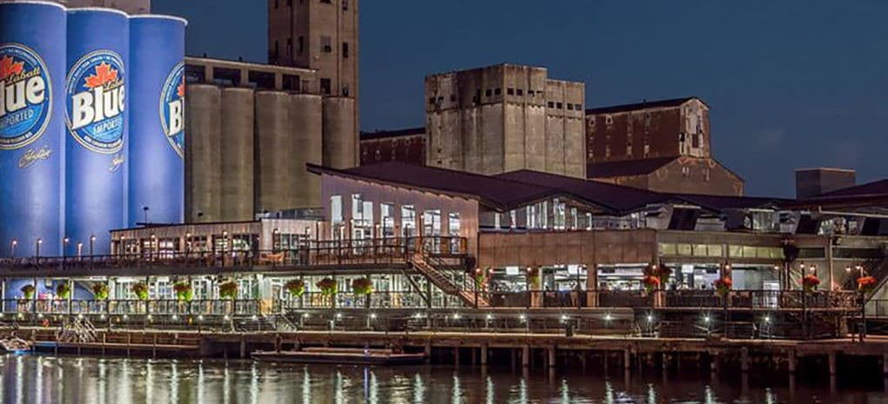
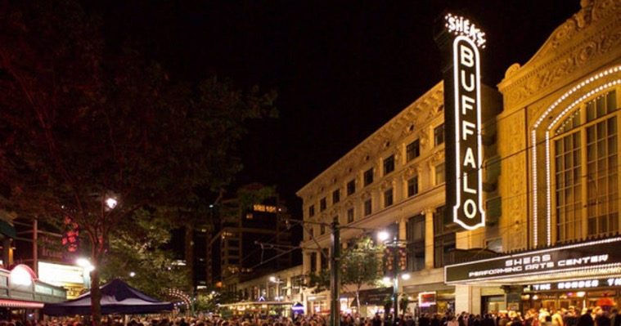


Slide 14

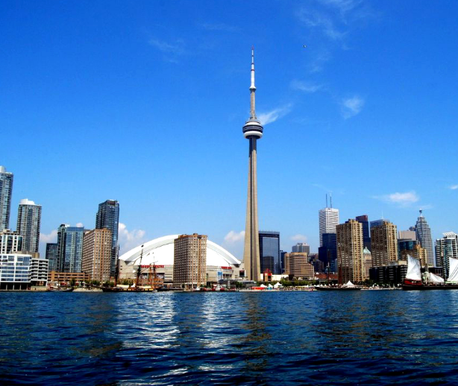
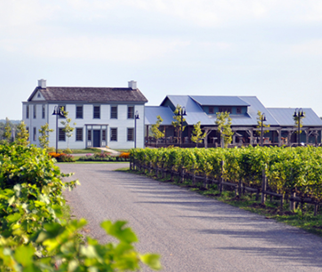
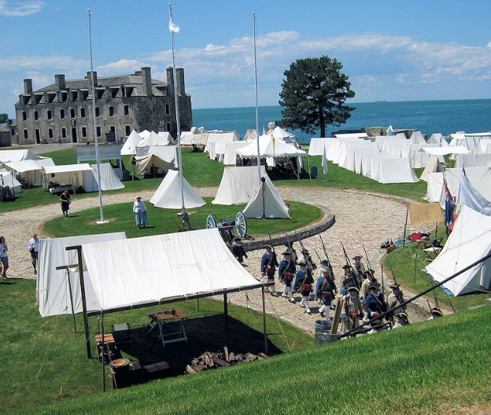
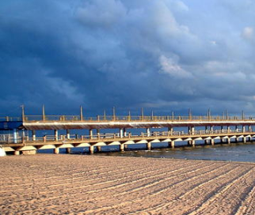
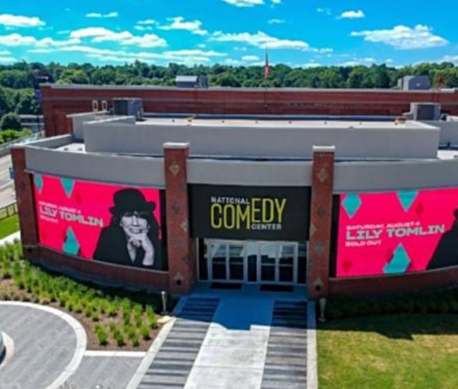

Slide 15



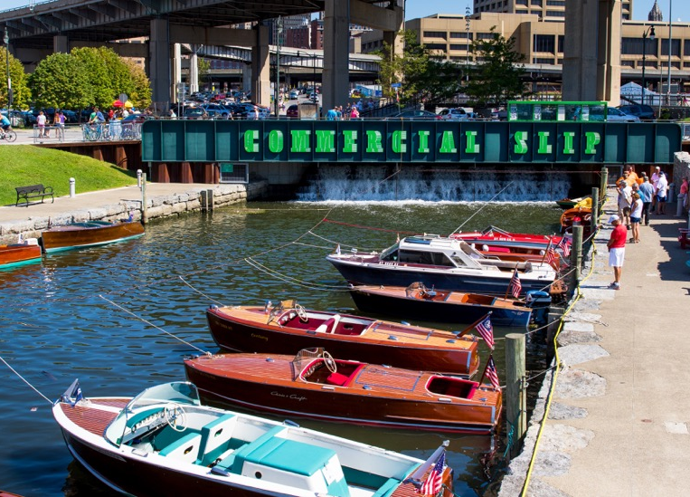

Slide 16

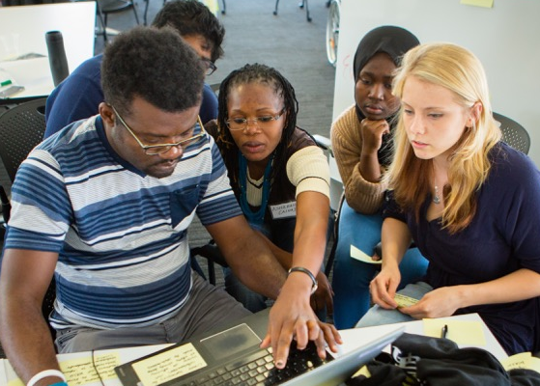
Intellectually Connected
21
67
15K
Colleges & universities in Buffalo Niagara region, 28K graduates annually
Colleges and universities
in the
Buffalo-Rochester Metro Corridor
technology degrees awarded
in 2016 (18.7%)
of all
degrees
Smart people attract smart people

Slide 17


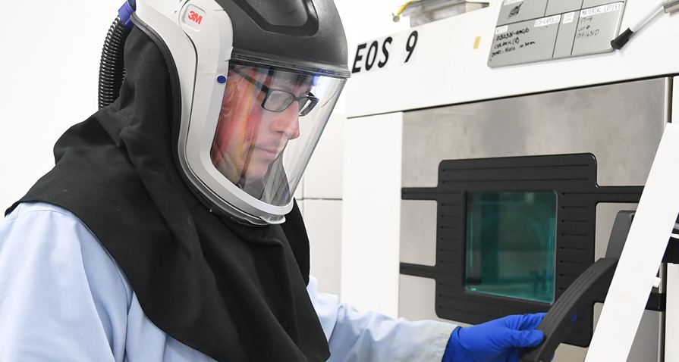

Who’s Hiring?
Start your search at BeInBuffalo.com

Slide 18
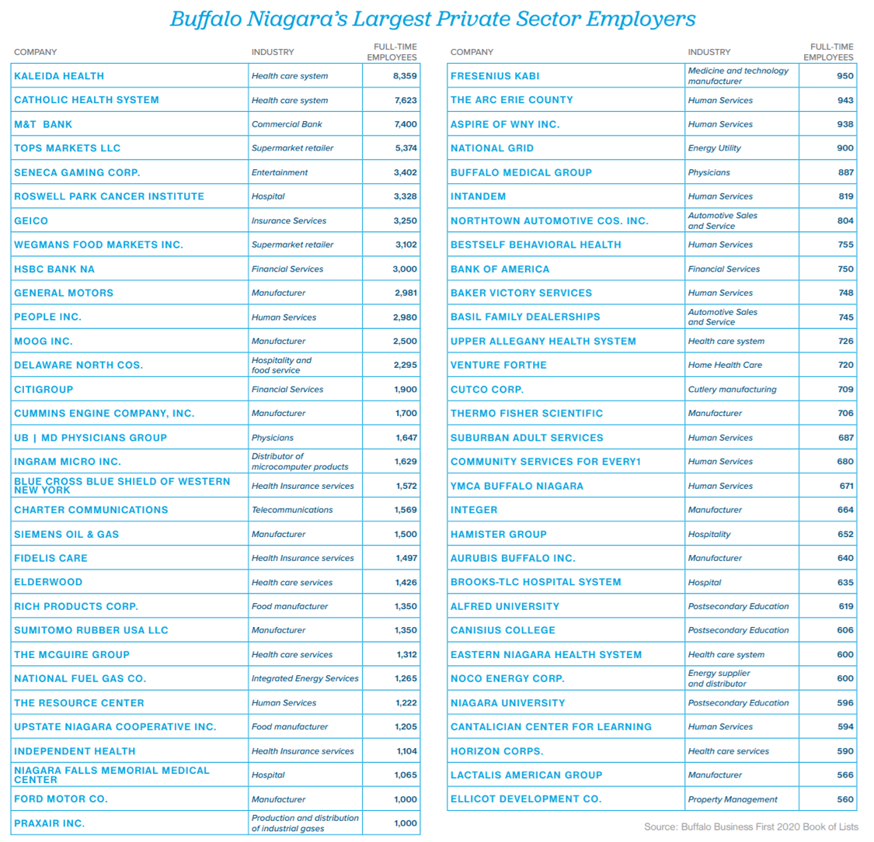
Largest
Employers

Slide 19
Regional Areas of Strength
Agribusiness
Dairy processing
Food processing
Advanced Business Services
Technology
Back office
Insurance
Data centers
Advance Manufacturing
Green energy
Electronic components
3D printing
Sensor technology
Life Science
Research & Development
Medical Device
Logistics & Distribution

Slide 20
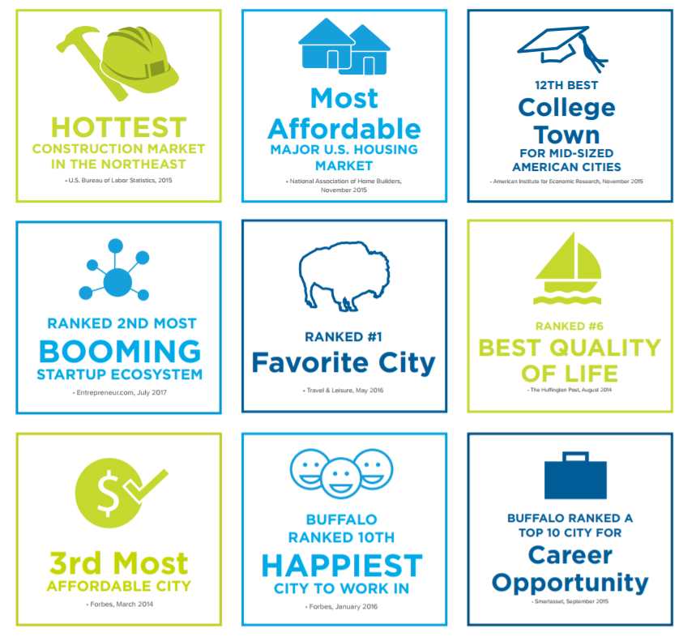
Don’t just take our word for it

Slide 21





